Slide 1

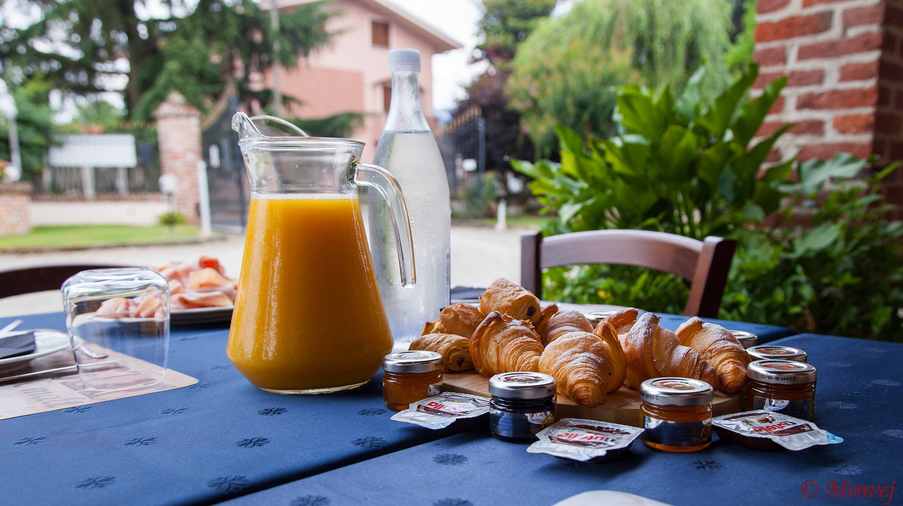
Welcome!
HBC Community Breakfast

Slide 2
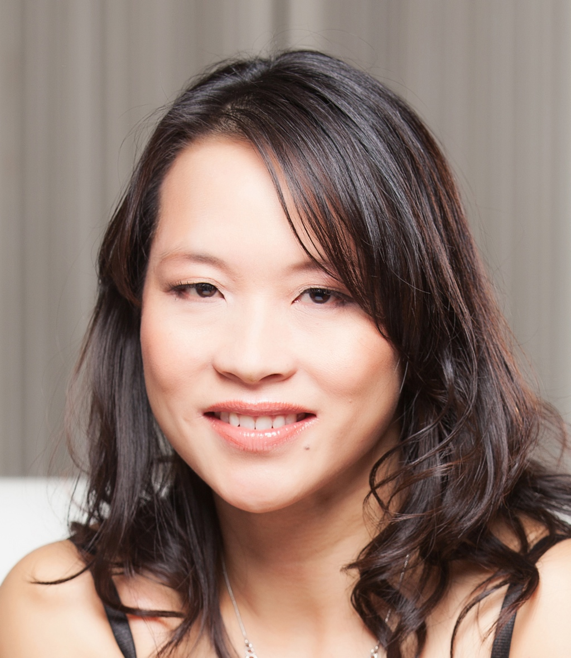
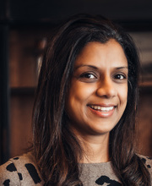
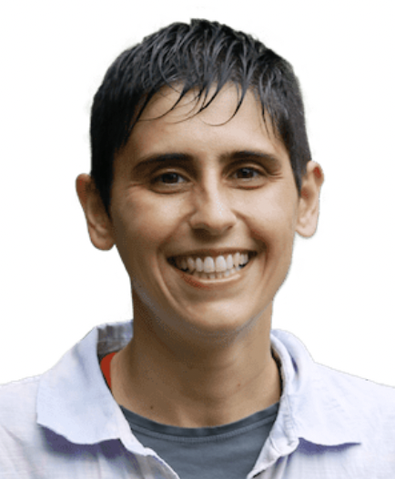
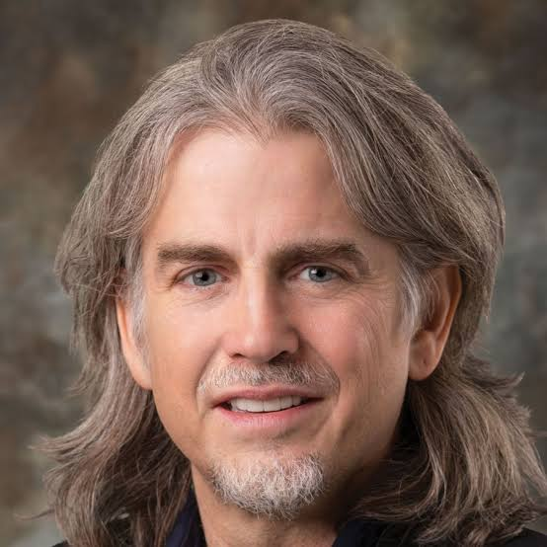
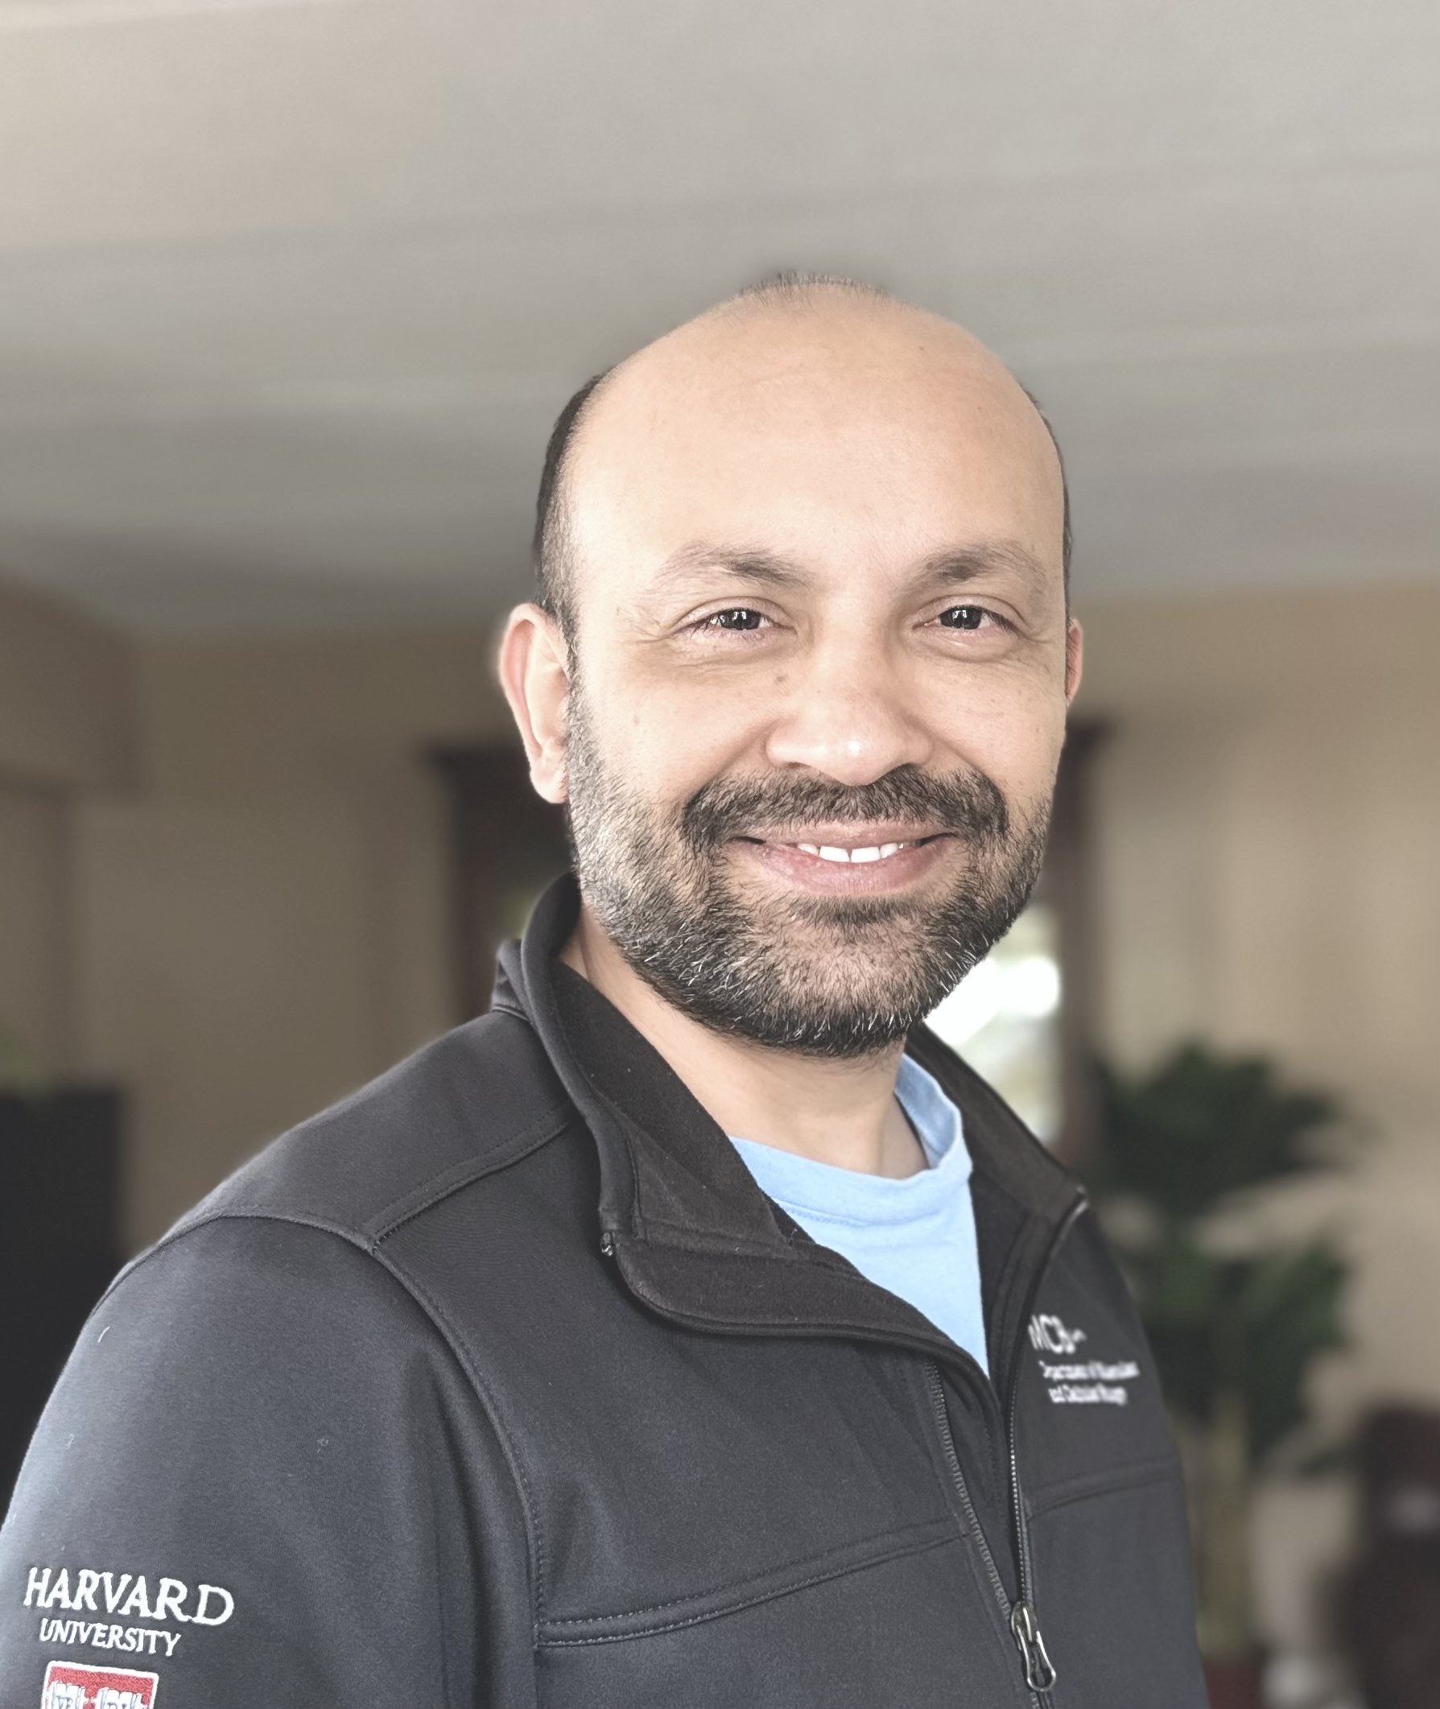
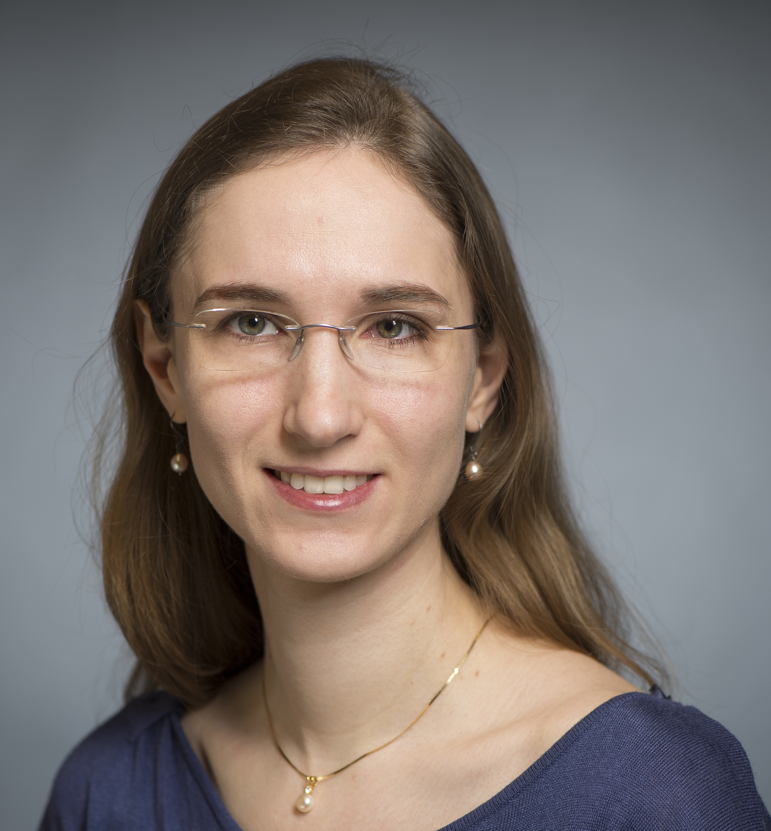
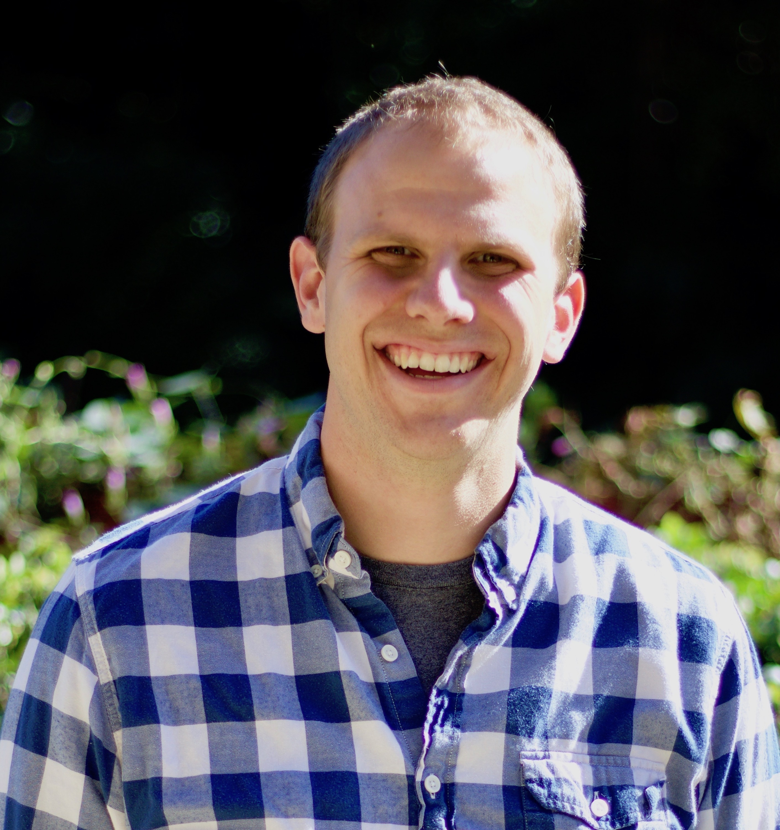
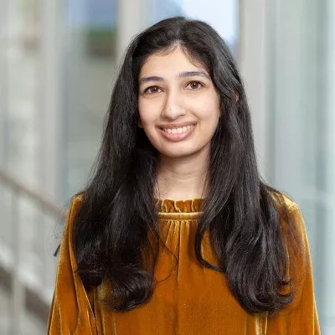
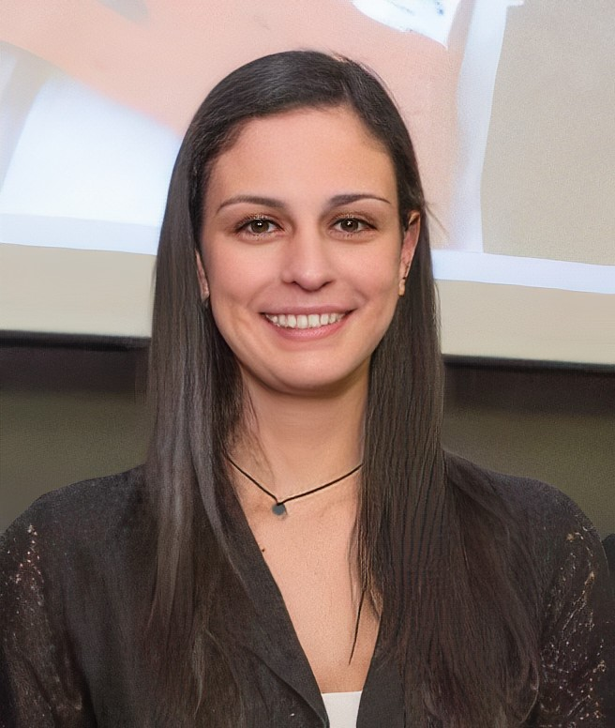
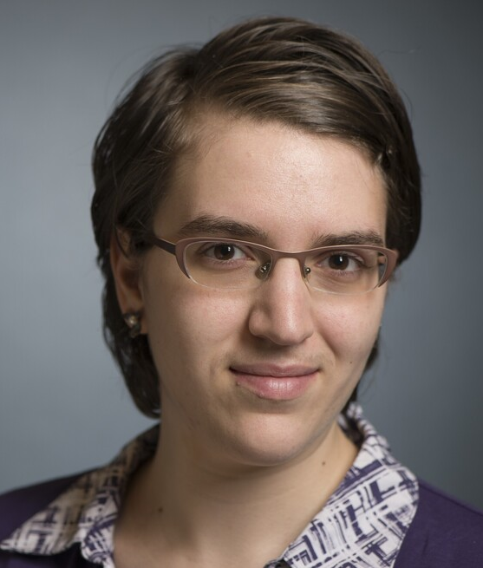
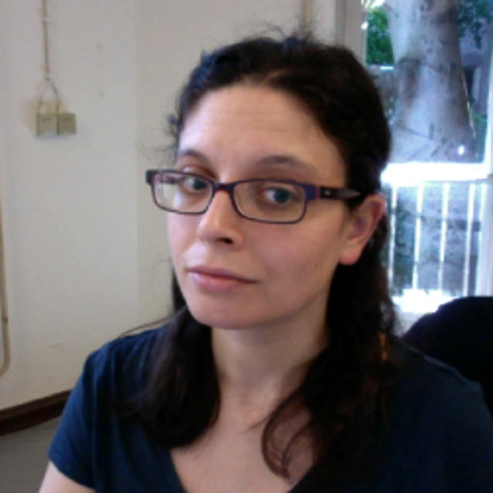
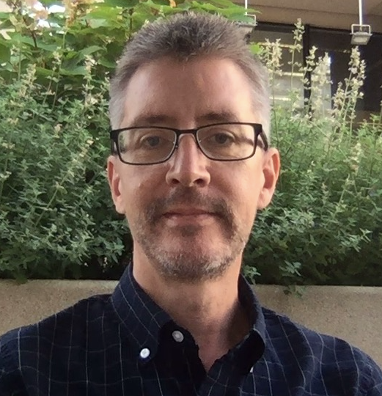
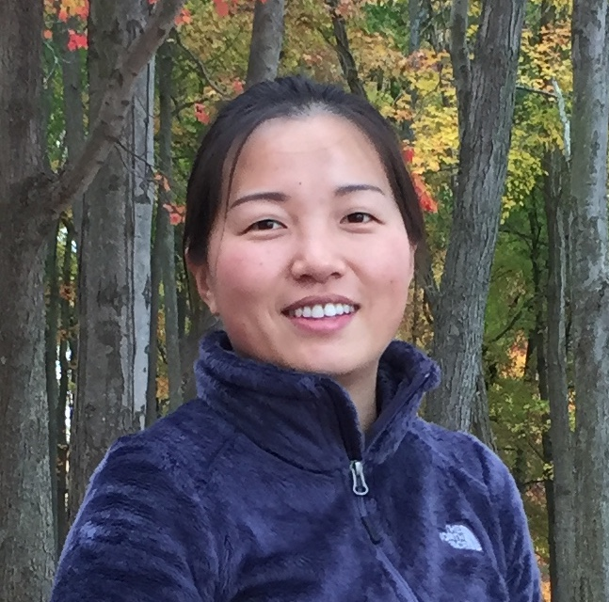
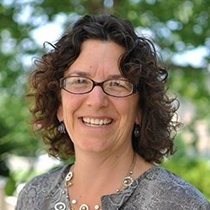
Shannan Ho Sui
Director
Meeta Mistry
Associate Director
Lorena Pantano
Director of Bioinformatics Platform
John Quackenbush
Faculty Advisor
Heather Wick
Noor Sohail
Upen Bhattarai
Heather Wick
Will Gammerdinger
Noor Sohail
Alex Bartlett
Elizabeth Partan
Emma Berdan
James Billingsley
Zhu Zhuo
Maria Simoneau

Slide 3
Welcome! HBC Community Breakfast
An opportunity to mingle and get to know each other in the community
Great conversations
Quarterly, 9am -10:30am – see you next in September!

Slide 4
Contact Us
HBC training team: hbctraining@hsph.harvard.edu
HBC consulting: bioinformatics@hsph.harvard.edu
O2 (HMS-RC): rchelp@hms.harvard.edu

